Slide 1
AICD BASE THEORY
Dr. Ajaykumar Gandhi
Assistant Professor
Department of Chemistry
Government College of Arts and Science
Aurangabad

Slide 2
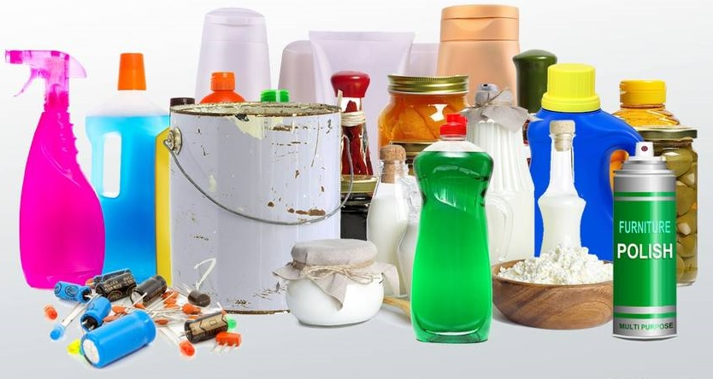
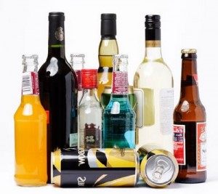
ACIDs
&
BASEs

Slide 3
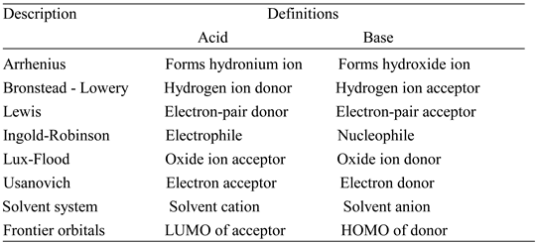

Slide 4
Arrhenius Acids and Bases
Acids are hydrogen-containing compounds that ionize to yield hydrogen ions (H⁺) in solution.
HA (aq) H⁺ (aq) + $A^{−}(aq)$
e.g. HCl(aq) H⁺ (aq) + ${Cl}^{−}(aq)$
Bases are compounds that ionize to yield hydroxide ions (OH–) in aqueous solution.
BOH (aq) B⁺ (aq) + ${HO}^{−}(aq)$
e.g. KOH (aq) K⁺ (aq) + ${HO}^{−}(aq)$
Notes:
4

Slide 5
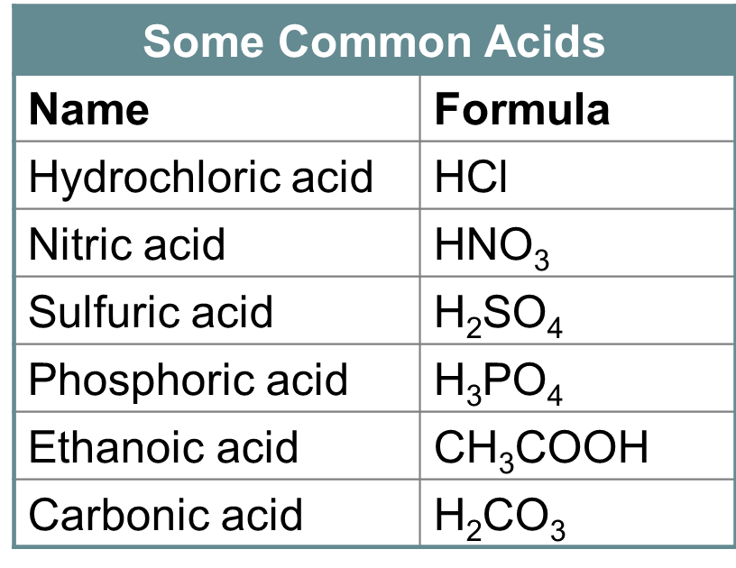

Slide 6
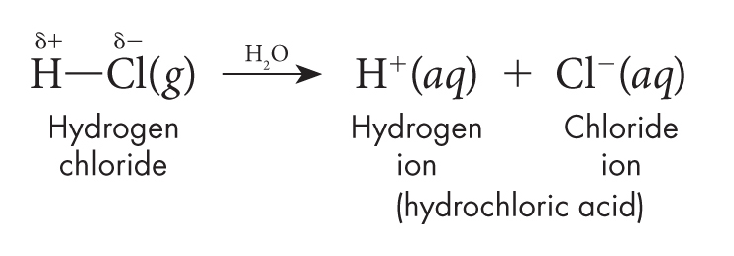
Arrhenius Acids
Not all compounds that contain hydrogen are acids.
Only a hydrogen that is bonded to a very electronegative element can be released as an ion. Such bonds are highly polar.
When a compound that contains such bonds dissolves in water, it releases hydrogen ions.
Notes:
6

Slide 7
In an aqueous solution, hydrogen ions are not present. Instead, the hydrogen ions are joined to water molecules as hydronium ions.
A hydronium ion (H₃O⁺) is the ion that forms when a water molecule gains a hydrogen ion.
Methane (CH₄) is an example of a hydrogen-containing compound that is not an acid.
The four hydrogen atoms in methane are attached to the central carbon atom by weakly polar ( almost non polar) C—H bonds.
Methane has no ionizable hydrogens and is not an acid.
Notes:
7

Slide 8
Arrhenius Bases
Some Common Bases
Name | Formula | Solubility in Water
Sodium hydroxide | NaOH | High
Potassium hydroxide | KOH | High
Calcium hydroxide | Ca(OH)₂ | Very low
Magnesium hydroxide | Mg(OH)₂ | Very low
Notes:
8

Slide 9
Brønsted-Lowry Acids and Bases
According to the Brønsted-Lowry theory,
an acid is a hydrogen-ion donor and
a base is a hydrogen-ion acceptor.
This theory includes all the acids and bases that Arrhenius defined.
It also includes some compounds that Arrhenius concept did not classify as bases.
Notes:
9

Slide 10
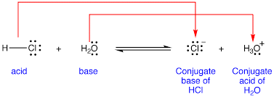
Base
Acid
Conjugate acid
Conjugate Base

Slide 11
Amphoteric Substances
They can act as both BL Acid or Base as per relative Acidic/Basic strength of other molecule.
E.g. H₂O, HCO₃⁻, HSO₄⁻ etc.
H₂O + H₂O HO⁻ + H₃O⁺
H₂CO₃ H⁺ + HCO₃⁻ H⁺ + CO₃²⁻
Using H₂SO₄ write for HSO₄⁻

Slide 12
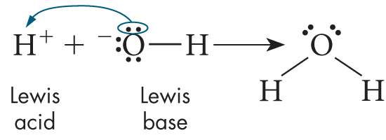
Lewis Acids and Bases
How did Lewis define an acid and a base?
A Lewis acid is a substance that can accept a pair of electrons to form a covalent bond.
A Lewis base is a substance that can donate a pair of electrons to form a covalent bond.
Consider the reaction of H⁺ and OH–.
The hydrogen ion donates itself to the hydroxide ion.
H⁺ is a Brønsted-Lowry acid, and OH⁻ is a Brønsted-Lowry base.
Notes:
12

Slide 13
A second example of a reaction between a Lewis acid and a Lewis base is what happens when ammonia dissolves in water.
Hydrogen ions from the dissociation of water are the electron-pair acceptor and the Lewis acid.
Ammonia is the electron-pair donor and the Lewis base.
The Lewis definition is the broadest.
It extends to compounds that the Brønsted-Lowry theory does not classify as acids and bases.
Notes:
13

Slide 14
Sample Problem 19.1
Identifying Lewis Acids and Bases
Identify the Lewis acid and the Lewis base in this reaction between ammonia and boron trifluoride.
NH₃ + BF₃ → NH₃BF₃
Notes:
14

Slide 15
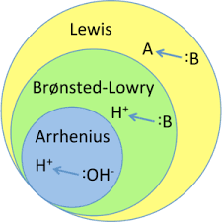
Are hydrogen-ion donors also electron-pair acceptors?
Yes. All substances defined as acids by the Brønsted-Lowry definition (an acid is a hydrogen-ion donor) are also defined as acids by the Lewis definition (an acid is an electron-pair acceptor). That means that these substances are both hydrogen-ion donors and electron-pair acceptors.
Notes:
15

Slide 16
Lux Flood Acid Base Theory
Acid is a –ve Ion (oxide O²⁻) acceptor
Base is a –ve Ion (oxide O²⁻) Donor

Slide 17
MgO + CO₂ MgCO₃
Base
Acid
CaO + SiO₂ CaSiO₃
NO₃− + S₂O₇² NO₂⁺ + 2 SO₄²⁻

Slide 18
Solvent system definition
It’s a Generalization of the Arrhenius definition to cover aprotic solvents
Terminology:
solvonium: A generic name for a positive ion.
Solvate : A generic name for a negative ion.
Definition:
Acid : Solute causing increase in the concentration of the solvonium ions and a decrease in the concentration of solvate ions.
Base : Solute causing decrease in the concentration of the solvonium ions and a increase in the concentration of solvate ions.

Slide 19
Like H₂O water its evident that NH₃ ammonia also undergo Auto-dissociation
H₂O + H₂O HO⁻ + H₃O⁺
NH₃ + NH₃ NH₂ ⁻ + NH₄⁺
N₂O₄ NO⁺ + NO₃⁻
2 SbCl₃ SbCl₂⁺ + SbCl₄⁻
COCl₂ COCl⁺ + Cl⁻
Thus, in liquid ammonia, KNH₂ (supplying NH₂⁻ is a strong base and NH₄NO₃ (supplying NH₄⁺ ) is a strong acid.
In liquid sulfur dioxide (SO₂), thionyl compounds (supplying SO²⁺) behave as acids, and sulfites (supplying SO₃²⁻) behave as bases.

Slide 21
Numerical on Acids and Bases

Slide 22
H₃O⁺, HO⁻, pH, pOH, Ka and pKa
Relations
${[H3O}^{+}]{[HO}^{−}]=$ $K_{w}$= $1×{10}^{−14}$
$$pH+pOH=14$$
$$pH=−log⁡{[H3O}^{+}]$$
$${[H3O}^{+}]={10}^{−pH}$$
$$pOH=−log⁡{[HO}^{−}]$$
$${[HO}^{−}]={10}^{−pOH}$$
$$pKa=−logKa$$
$$Ka={10}^{−pKa}$$
$$Ka×Kb=1.0×{10}^{−14}$$
$pKb=−logK$b
$$Kb={10}^{−pKb}$$
$$pH =pKa+log⁡[\frac{Base or Conjugate Base}{Conjugate Acid or Acid}]$$
Henderson–Hasselbalch equation

Slide 23
Ex.1 What is the pH of 0.025 M aq. HCl solution ?
HCl is strong acid and ionizes completely, hence,
$[{H3O}^{+}]=$ [HCl] = 0.025 M
Formula:
$$pH=−log⁡{[H3O}^{+}]=−log⁡[0.025]=1.60$$
Ex.2 What is the pH of 0.025 M aq. NaOH solution ?
NaOH is a strong acid and ionizes completely, hence, ${[HO}^{−}]=\left[NaOH\right]=0.025 M$
Let’s find pOH first
Formula:
$$pOH=−log⁡{[HO}^{−}]=−log⁡[0.025]=1.60$$
Then,
$$pH+pOH=14$$
$$pH=14−pOH=14−1.60=12.40$$
$$pH=12.40$$

Slide 24
ACIDs
&
BASEs
Continued……..

Slide 25
pH of Weak Acids and Bases

Slide 26
H₃O⁺, HO⁻, pH, pOH, Ka and pKa
Relations
${[H3O}^{+}]{[HO}^{−}]=$ $K_{w}$= $1×{10}^{−14}$
$$pH+pOH=14.00$$
$$pH=−log⁡{[H3O}^{+}]$$
$${[H3O}^{+}]={10}^{−pH}$$
$$pOH=−log⁡{[HO}^{−}]$$
$${[HO}^{−}]={10}^{−pOH}$$
$$pKa=−logKa$$
$$Ka={10}^{−pKa}$$
$$Ka×Kb=1.0×{10}^{−14}$$
$pKb=−logK$b
$$Kb={10}^{−pKb}$$
$${pK}_{a}+{pK}_{b}=14.00$$
$$pH =pKa+log⁡[\frac{Base or Conjugate Base}{Conjugate Acid or Acid}]$$
Henderson–Hasselbalch equation

Slide 27
Ex.1 What is the pH of 0.025 M aq. HCl solution ?
HCl is strong acid and ionizes completely, hence,
$[{H3O}^{+}]=$ [HCl] = 0.025 M
Formula:
$$pH=−log⁡{[H3O}^{+}]=−log⁡[0.025]=1.60$$
Ex.2 What is the pH of 0.025 M aq. NaOH solution ?
NaOH is a strong acid and ionizes completely, hence, ${[HO}^{−}]=\left[NaOH\right]=0.025 M$
Let’s find pOH first
Formula:
$$pOH=−log⁡{[HO}^{−}]=−log⁡[0.025]=1.60$$
Then,
$$pH+pOH=14$$
$$pH=14−pOH=14−1.60=12.40$$
$$pH=12.40$$

Slide 28
Ex.3 Calculate pH of 100.0 mL of 0.025 M aq.HA acid ($Ka=2.5×{10}^{−8}$).
For given Acid HA Ka is very small and hence HA is weak acid and ionizes to very little extent.
$[{H3O}^{+}]≠$ [HA] = 0.2 M
What this means,? ….. We just cannot say that
We have to find out actual [H₃O⁺] = ?
Using ionization constant we can find out extent of ionization of
Pertinent ionization equation for weak acid HA in aqueous medium is,
HA (aq) ${H3O}^{+}\left(aq\right)+A^{−}(aq)$
At equilibrium,
$$K_{a}=\frac{\left[{H3O}^{+}\right][A^{−}]}{[HA]}=2.5×{10}^{−8}$$
……….(1)

Slide 29
As, HA is a weak acid, it will ionize only to little extent and completely.
Let, at Equilibrium, ”x” M of HA ionizes into ${H3O}^{+}\left(aq\right) and A^{−}(aq)$.
Accordingly we write ICE table as,
HA (aq) ${H3O}^{+}\left(aq\right) + A^{−}(aq)$
Let’s put these equilibrium Concentrations in Eq.1
Conc. (M) | HA (aq) | $${H3O}^{+}\left(aq\right)$$ | $$A^{−}(aq)$$
Initial | 0.025 M | 0 | 0
Change | $$−X$$ | $$−X$$ | $$−X$$
Equilibrium | $$(0.025−X)$$ | X | X
$$K_{a}=\frac{(X)×(X)}{(0.025−X)}=2.5×{10}^{−8}$$
$$\frac{X^{2}}{(0.025−X)}=2.5×{10}^{−8}$$
$∴X^{2}=(0.025−X)[2.5×{10}^{−8}$]
$∴X^{2}=(6.25×{10}^{−10})−$ $[2.5×{10}^{−8}$]X
$∴X^{2}+$ $[2.5×{10}^{−8}$]X $=(6.25×{10}^{−10})$
Approximation Rule.
<5% Ionization.
Let’s solve this quadratic equation by Perfect square method,

Slide 30
$$\left(6.25×{10}^{−10}\right)+(0.00000156×{10}^{−10})$$
Add,
$Third Term=1.56×{10}^{−16}$ to both sides of above equation,
$$\left(6.25×{10}^{−10}\right)+(1.56×{10}^{−16})$$
$∴X^{2}+$ $\left[2.5×{10}^{−8}\right]X+1.56×{10}^{−16}]=\left(6.25×{10}^{−10}\right)+(1.56×{10}^{−16})$
?
$$(X+1.25{{×10}^{−8})}^{2}={6.25×10}^{−10}$$
Just neglect
$$X+{(1.25×10}^{−8})=±2.5×{10}^{−5}$$
$$X+{(1.25×10}^{−8})=+2.5×{10}^{−5}$$
or
$$X+{(1.25×10}^{−8})=−2.5×{10}^{−5}$$
$$X=\left(2.5×{10}^{−5}\right)−(1.25×{10}^{−8})$$
Not Acceptable
$$X=\left(2.5×{10}^{−5}\right)−(0.00125×{10}^{−5})$$
$$X=2.499×{10}^{−5}$$
By ICE table,
${[H3O]}^{+}=X=2.499×{10}^{−5}$ M

Slide 31
$$pH=−log⁡({2.499×10}^{−5})$$
From Slide 6
Approximation Rule.
<5% Ionization.
$$pH=4.60$$
$$pOH=14.00−pH=14.00−4.60=9.40$$
$$\frac{X^{2}}{(0.025−X)}=2.5×{10}^{−8}$$
$$X^{2}=(0.025−X)(2.5×{10}^{−8})$$
$X≪0.025$, So, $0.025−X≈0.025$, then,
$$X^{2}=0.025(2.5×{10}^{−8})$$
$$X^{2}=6.25×{10}^{−10}$$
$$X=2.500×{10}^{−5}$$
pH = 4.60 and pOH = 9.40

Slide 32
Ex.3 Calculate pH of 100.0 mL of 0.025 M aq.BOH acid ($Kb=2.5×{10}^{−8}$).
BOH (aq) ${HO}^{−}\left(aq\right) + B^{+}(aq)$
Conc. (M) | BOH (aq) | $${HO}^{−}\left(aq\right)$$ | $$A^{+}(aq)$$
Initial | 0.025 M | 0 | 0
Change | $$−X$$ | $$−X$$ | $$−X$$
Equilibrium | $$(0.025−X)$$ | X | X
Try Out Yourself…….

Slide 33
Buffer Solutions
Buffers are solutions that resist a change in pH on dilution or on addition of small amounts of Acids or alkali.
Buffers are made up of Weak Acid/Weak Base and It’s Conjugate Base/ Conjugate Acid respectively.
Buffer Action:
Acidic Buffer: e.g. AcOH/AcONa buffer.
AcOH (aq) ${AcO}^{−}(aq)+{H3O}^{+}$
AcONa(aq) ${AcO}^{−}(aq)+{Na}^{+}$
When you add Acid i.e. ${H3O}^{+} to this buffer, {AcO}^{−}$ions consumes it and gives dissociated AcOH.
When you add Base i.e. ${HO}^{−} to this buffer, {H3O}^{+}$ions consumes it and gives water H₂O molecule.

